Slide 1
Basic Game Object Manipulation and Transformations

Slide 2
Objectives
Understand the concept of game objects and their role in Unity.
Learn basic game object manipulation techniques.
Grasp the fundamentals of transforming game objects in Unity.

Slide 3
Content
Understand the concept of game objects and their role in Unity.
Learn basic game object manipulation techniques.
Grasp the fundamentals of transforming game objects in Unity.

Slide 4
What are Game Objects?
GameObjects are the foundational components of a Unity game project.
“GameObjects are the fundamental objects in Unity that represent characters, props and scenery. They do not accomplish much in themselves but they act as containers for Components, which implement the functionality.”^{[8]}
Every object in your game is a GameObject, from characters and collectible items to lights, cameras and special effects.
2: Buttfield-Addison Paris, Manning Jon, Nugent Tim, Unity game development cookbook: essentials for every game, 2019
8: Unity Technologies, Unity Manual, 2023

Slide 5
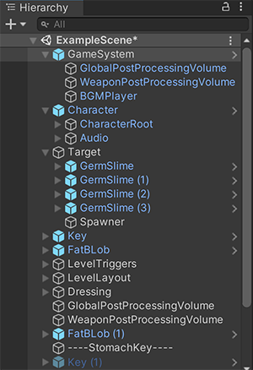
Hierarchy Panel - GameObjects - Nested
A parent GameObject has other GameObjects connected to it that take on its Transform properties.
A child GameObject is connected to another GameObject, and takes on that GameObject’s Transform properties.
A child GameObject moves, rotates, and scales exactly as its parent does. Child GameObjects can also have child GameObjects of their own. A GameObject can have multiple child GameObjects, but only one parent GameObject.
Notes:
Nesting is the term for establishing a relationship between two or more items

Slide 6
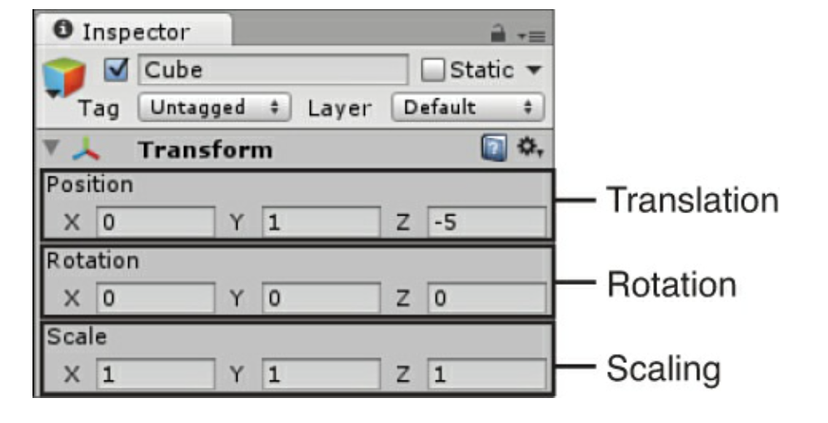
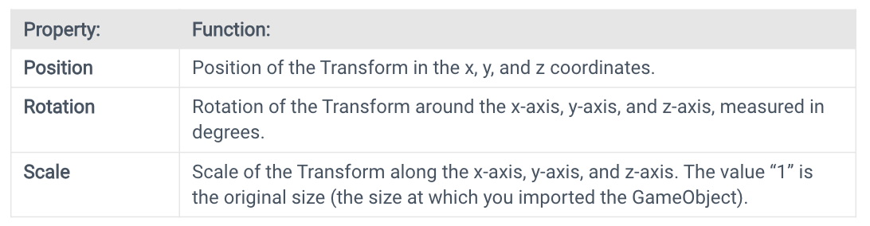
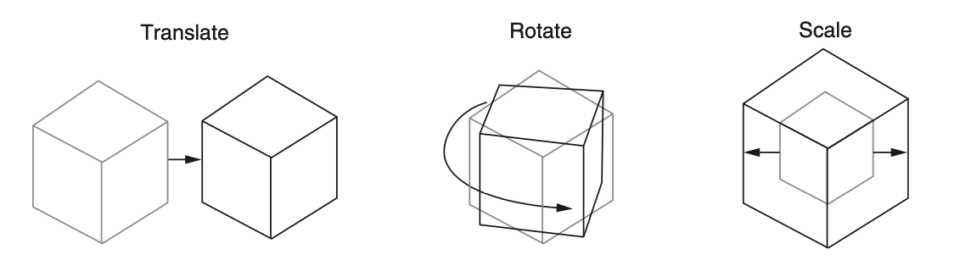
Transforms
“The Transform stores a GameObject’s Position, Rotation, Scale and parenting state. A GameObject always has a Transform component attached: you can’t remove a Transform or create a GameObject without a Transform component.”^{[8]}
1: Hocking, Joseph; Schell, Jesse, Unity in action: multiplatform game development in C#, 2022
3: Geig, Mike, Sams teach yourself Unity Game development in 24 hours, 2014
Notes:
“Every game object has at least one component: a Transform. The Transform component stores the position, rotation, and scale of an object, and is also responsible for keeping track of the parent of an object. You can’t remove the Transform component”[2]

Slide 7
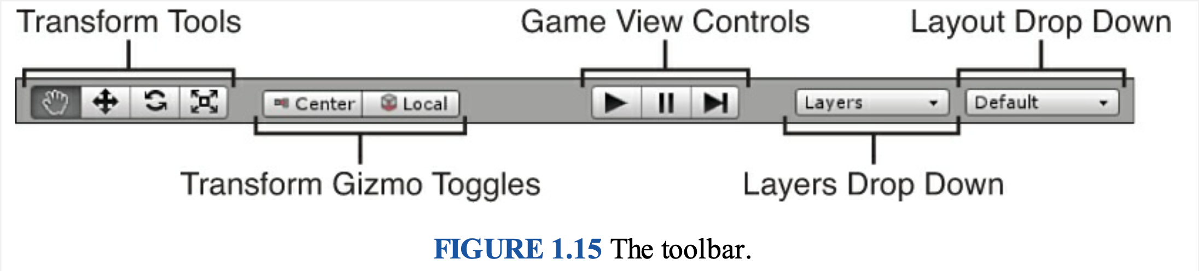
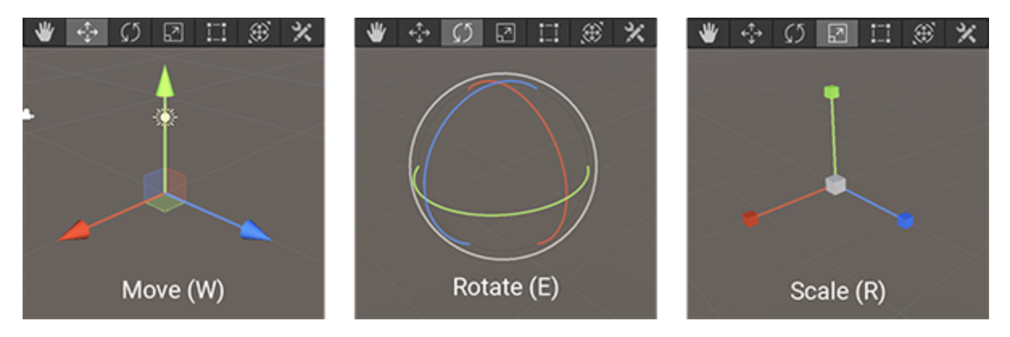
Transform Tool
You can use the Transform tools on any GameObject in a scene.
When you select a GameObject, the tool Gizmo appears within it. The appearance of the Gizmo depends on which tool you select.

Slide 8
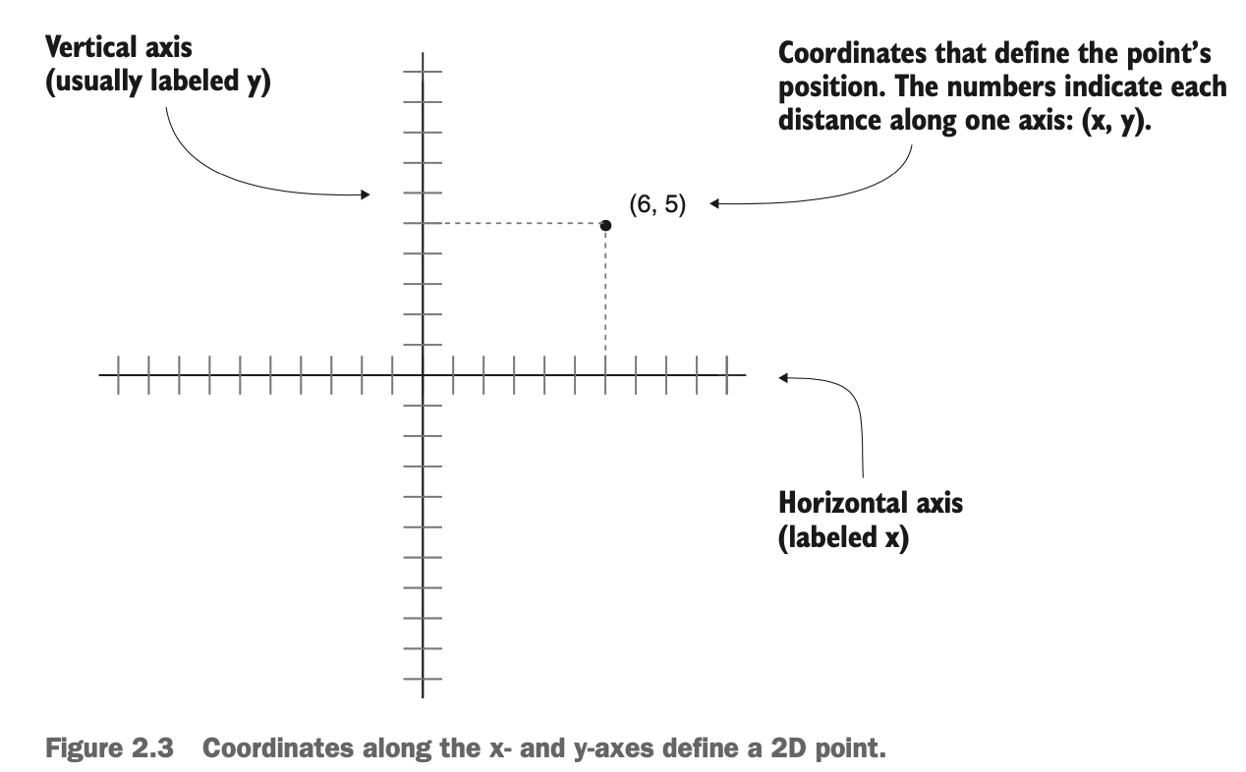
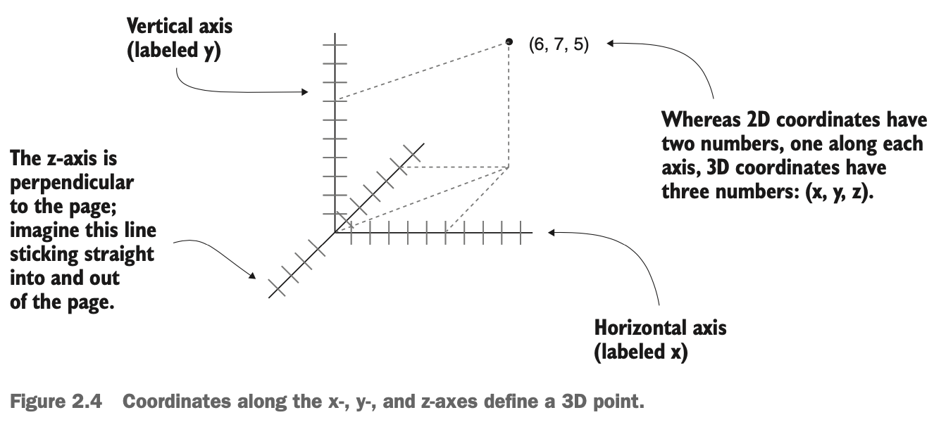
Transforms - Understanding 3D coordinate space
1: Hocking, Joseph; Schell, Jesse, Unity in action: multiplatform game development in C#, 2022

Slide 9
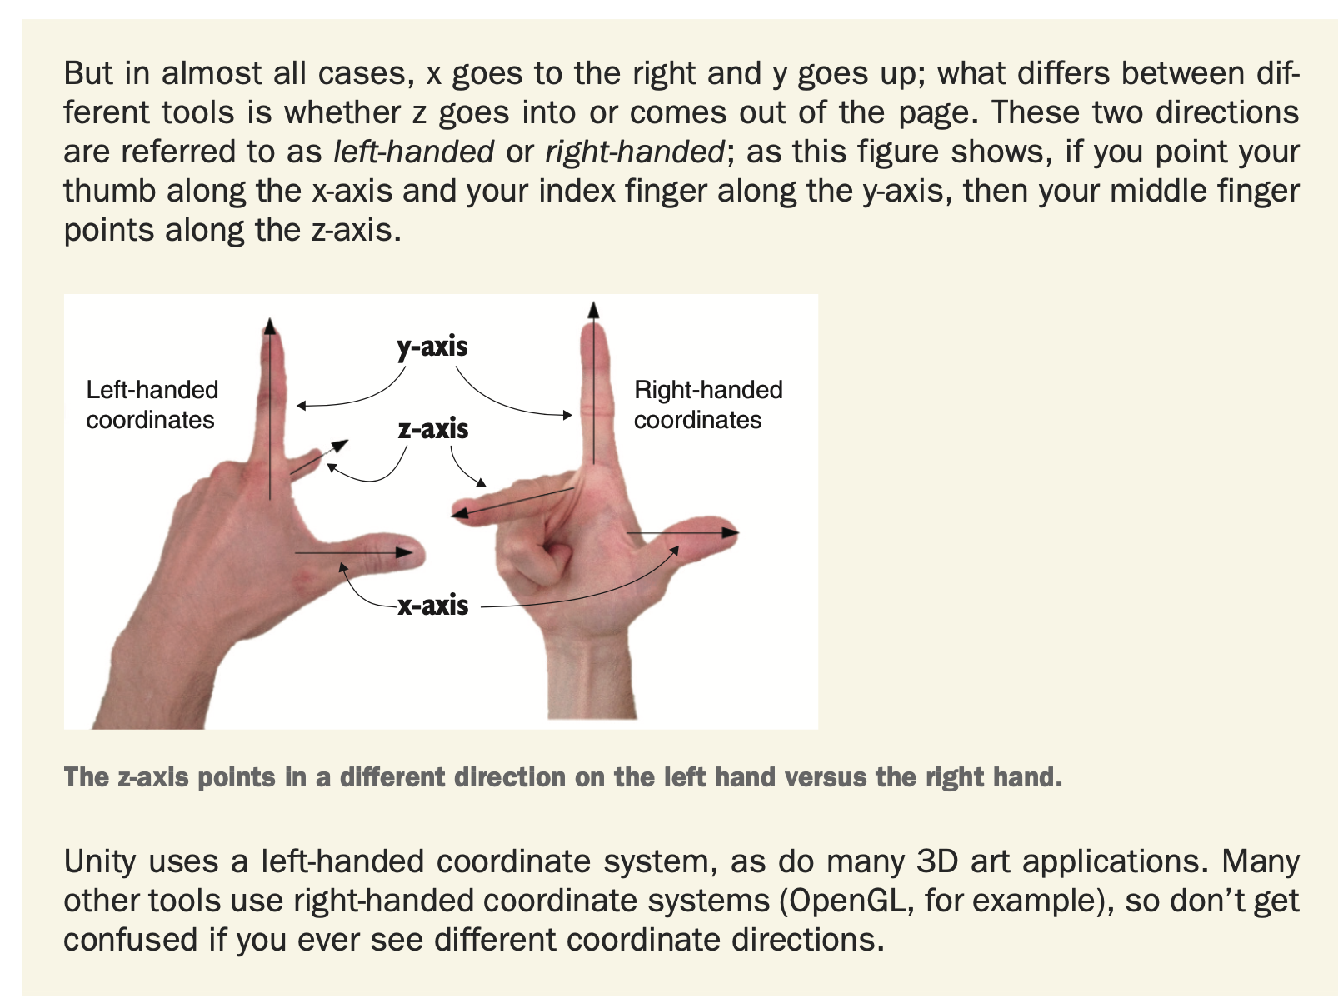
Transforms - Understanding 3D coordinate space cont
1: Hocking, Joseph; Schell, Jesse, Unity in action: multiplatform game development in C#, 2022

Slide 10
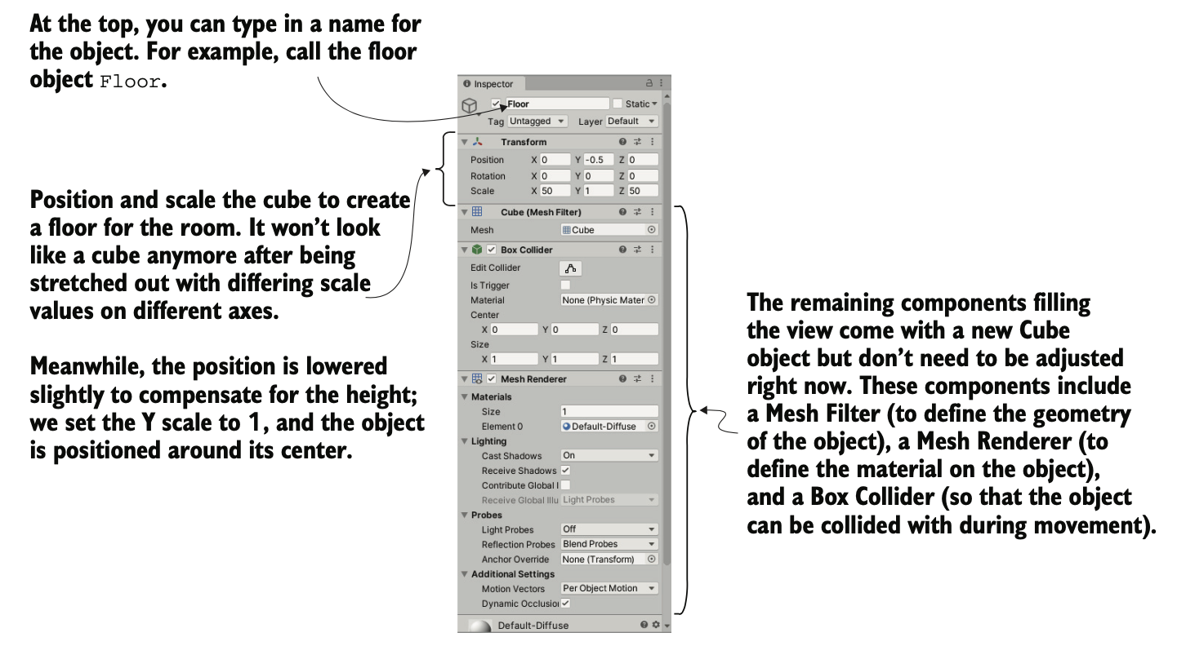
Transform Component in Inspector
1: Hocking, Joseph; Schell, Jesse, Unity in action: multiplatform game development in C#, 2022

Slide 11
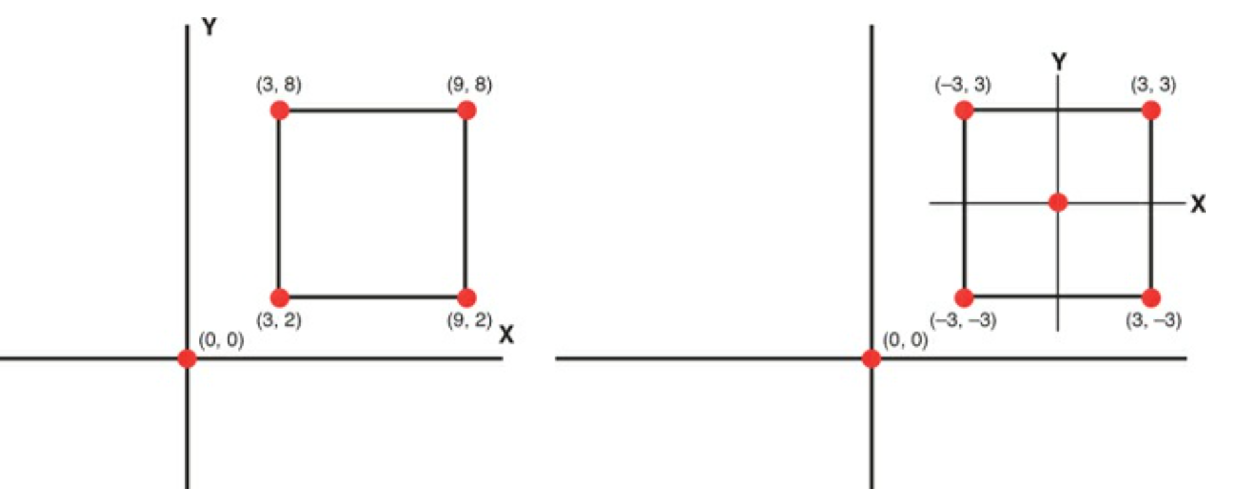
Understanding local vs. world coordinate space
Every game object in Unity has a position, but a position needs a reference frame. In particular, Unity offers two ways to see (and set) coordinates:
World coordinates: These are absolute coordinates of where the game object is located (by absolute, I mean with respect to the world frame, which is considered to be absolute in the game)
Local coordinates: These are the coordinates of where the game object is with respect to its parent

Slide 12
Parenting and Child Relationships
“Game objects can be the child of other game objects. When a game object moves, rotates, or scales, its children are affected as well. This means that you can create hierarchies of game objects that work together as a system; for example, a car could have each of its four wheels as child objects, which means that they automatically stay in the correct position as the car moves around.”^{[2]}
TIPs: Before linking any child objects to it, make sure to reset the Trans- form options (Position and Rotation to 0, 0, 0 and Scale to 1, 1, 1) of the empty root object to avoid any oddities in the position of child objects.
2: Buttfield-Addison Paris, Manning Jon, Nugent Tim, Unity game development cookbook: essentials for every game, 2019
Notes:
Transformations applied to the parent object work as normal. The object can be moved, scaled, and rotated. What’s special is how the child object behaves. Once nested, a child object’s transform is relative to that of the parent object, not the world. Therefore, a child object position is not based on its distance from the origin, but the distance from the parent object. If the parent object is rotated, the child object would move with it. If you looked at the child’s rotation, however, it would not register that it had rotated at all. The same goes for scaling. If you scale the parent object, the child also changes in size. The scale of the child object would remain unchanged.
You might be confused by why this is. Remember, when a transformation is applied, it is not applied to the object, but to the object’s coordinate system. An object isn’t rotated, its coordinate system is. The effect is that the object turns. When a child object’s coordinate system is based on the local coordinate system of the parent, any changes to the parent system will directly change the child (without the child knowing about it).
[3]

Slide 13
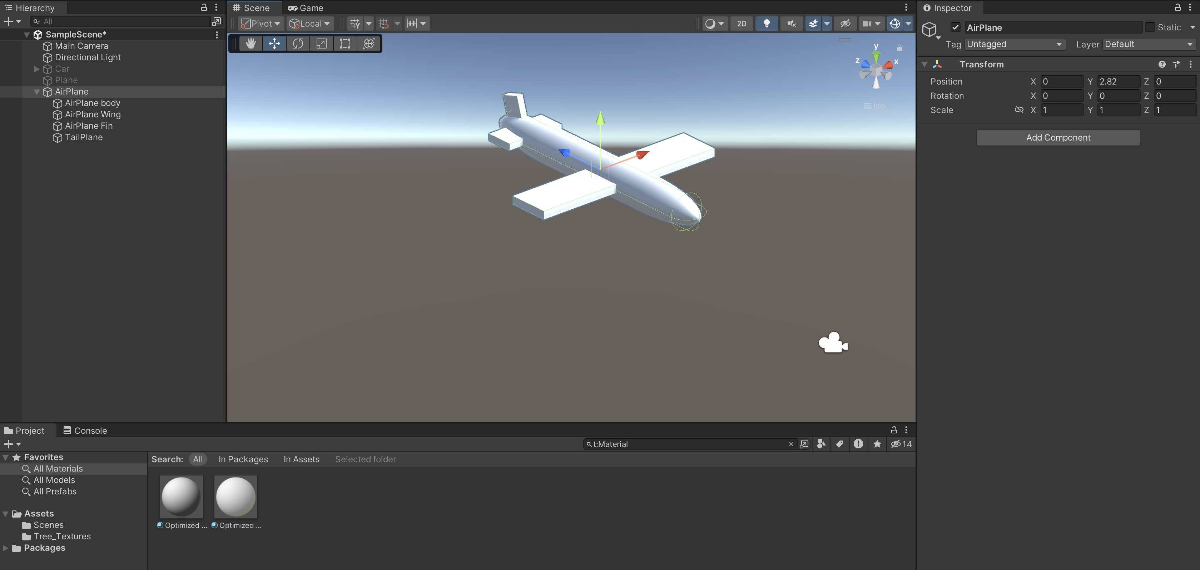
Pratice
In order to understand the moving of GameObject’s transform, use Unity 3D for this practice.

Slide 14
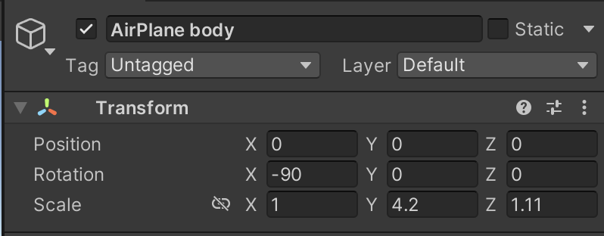
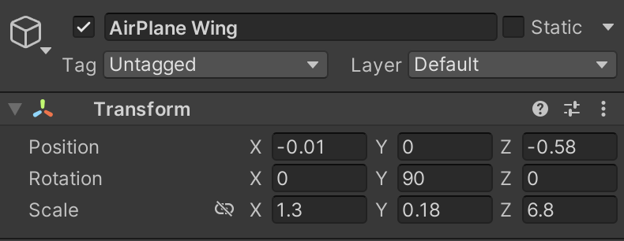
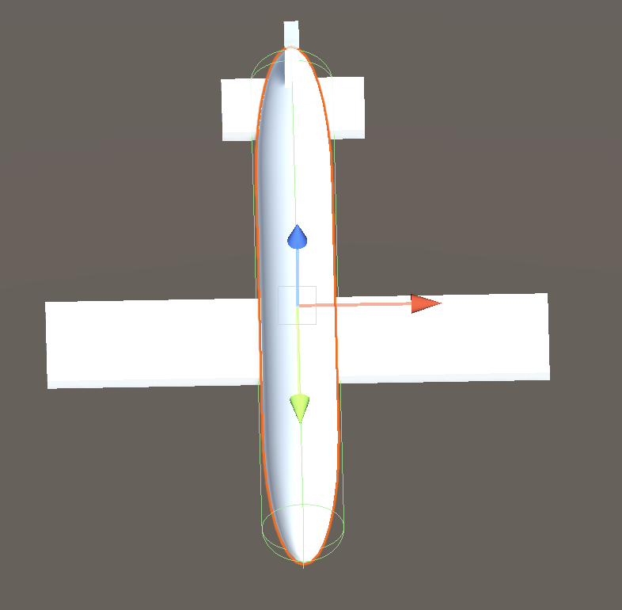
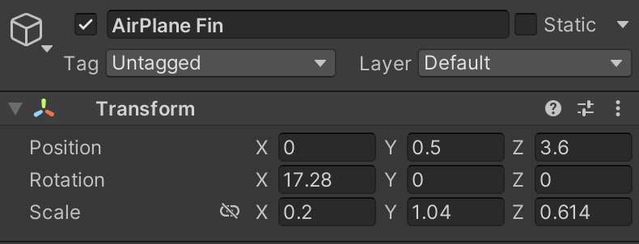
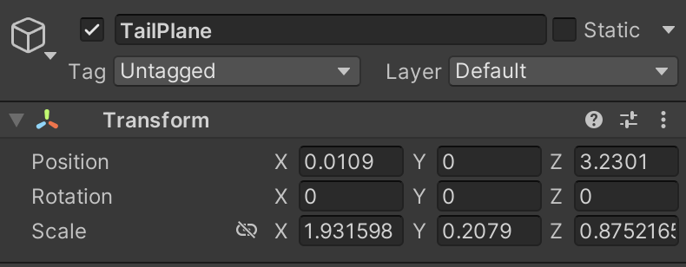
Pratice – Use transform tool to create 3D Objects
1. Add Capcule 3D GameObject. Rotate, scale it to make plane body.
2. Add Cube. Use React, scale, rotate and move tool to make airplane’s wing
3. Add two Cube. Use React, scale, rotate and move tool to make airplane’s fin and tailplane

Slide 15
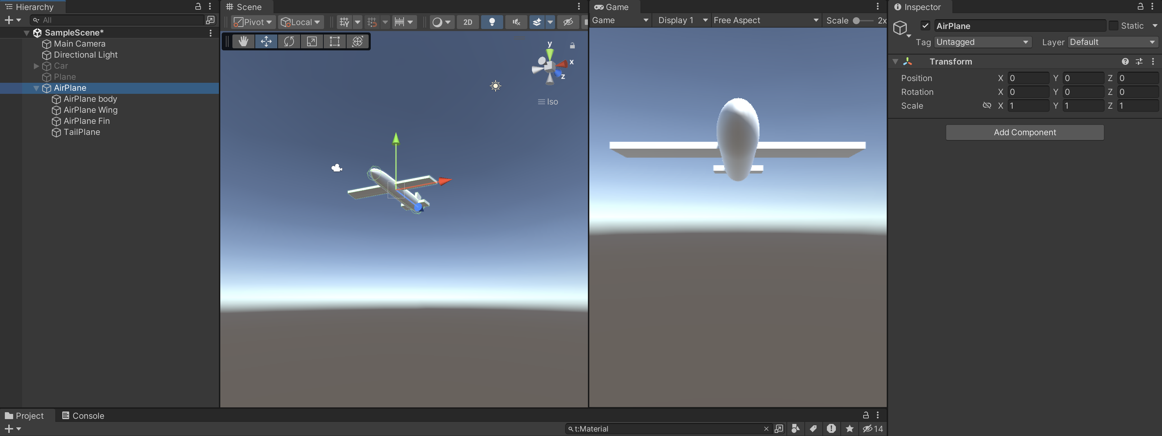
Create nested object
1. Create empty 3D GameObject. Make sure the Position and Rotation values is 0 and Scale values is 1. Rename this empty object to AirPlane
2. Drop all airplane parts to AirPlane.
3. Move, rotate and scale AirPlane object to check the transform of other airplane’s part
4. Reset Transform value of Airplane.

Slide 16
Conclusions
Explored game object fundamentals and their significance in Unity scenes.
Learned manipulation techniques—selecting, moving, rotating, and scaling objects.
Mastered Transform component usage and understood coordinate systems' impact.
Grasped parent-child relationships' influence on object transformations.

Slide 17
References
1: Hocking, Joseph; Schell, Jesse, Unity in action: multiplatform game development in C#, 2022
2: Buttfield-Addison Paris, Manning Jon, Nugent Tim, Unity game development cookbook: essentials for every game, 2019
3: Geig, Mike, Sams teach yourself Unity Game development in 24 hours, 2014
8: Unity Technologies, Unity Manual, 2023

